Slide 1
Employee Data Analysis using Excel
STUDENT NAME: VARSHA T.S
REGISTER NO: 312217087(asunm1659312217087)
DEPARTMENT: B.com(GENERAL)
COLLEGE: SHRI KRISHNASWAMY COLLEGE FOR WOMEN

Slide 2
PROJECT TITLE
VISUALIZING EMPLOYEE ATTENDANCE TRENDS WITH EXCEL CHART

Slide 3


AGENDA
Problem Statement
Project Overview
End Users
Our Solution and Proposition
Dataset Description
Modelling Approach
Results and Discussion
Conclusion
3/21/2024 Annual Review

Slide 4

PROBLEM STATEMENT
•This project aims to visualize employee attendance data to identify patterns, trends, and areas for improvement. •By Analysing employee attendance records, we will gain insights into absenteeism rates, tardiness, and overtime hours. •Through effective visualizations, we will provide HR and management teams with actionable data to enhance employee productivity and addressed attendance -related challenges.

Slide 5

PROJECT OVERVIEW
•Data collection and cleaning: Gathering and preparing relevant employee attendance data, ensuring accuracy and completeness.
•Data analysis: Analysing attendance patterns, calculating key metrics (e.g., absenteeism rates, tardiness, overtime), and identifying correlations.
•Visualization: Creating interactive and informative visualizations (e.g., charts, graphs, dashboards) to present findings effectively.

Slide 6

WHO ARE THE END USERS?
•HR Manager •Payroll Specialist •Operation Manager •Business Analyst •Department Heads

Slide 7

OUR SOLUTION AND ITS VALUE PROPOSITION
SOLUTION Improved Decision Making: Visualizations provide actionable insights for HR and management. VALUE PROPOSITION
•Immediate decision-making and proactive measures to address attendance issues. •Predictive analytics for forecasting attendance needs and optimizing workforce planning. •Increased employee satisfaction, motivation, and overall productivity.

Slide 8
Dataset Description
•Name : Employee's full name. •Date : Specific dates for attendance records. •Check -in Time: Time when the employee starts their workday. •Check -Out Time : Time when the employee ends their workday. •Status : Attendance status (Eg. Present, Absent, Late, Early Leave). •Department : Department to which the employee belongs
•Hours Worked :Total hours worked each day •Leave Type : Type of leave (e.g., Sick, Vacation, Personal) if applicable

Slide 9

THE "WOW" IN OUR SOLUTION
SOLUTIONS Improved Decision Making: Visualizations provide actionable insights for HR and management. Enhanced Employee Engagement: Transparent attendance data can foster trust and accountability.
3/21/2024 Annual Review
9

Slide 10
MODELLING
•Clean and process : Ensure data accuracy by handling missing values, outliers, and inconsistencies. •Define metrics: Identify relevant metrics like absenteeism rate, tardiness rate,
vertime hours, and productivity. •Bar charts: Compare attendance across different departments, teams, or time periods. •Filters: Allow users to filter data based on various criteria (e.g., department, time period).
10

Slide 11
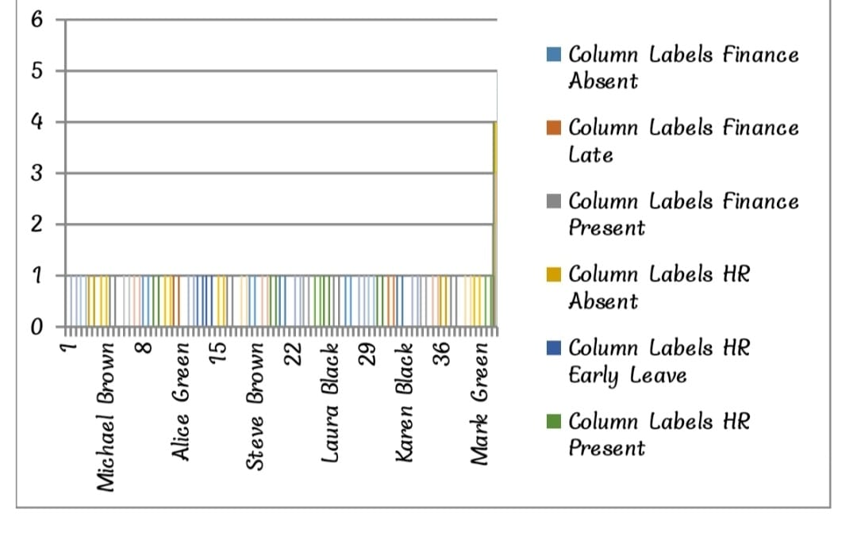
RESULTS
11

Slide 12
conclusion
Visualizing employee attendance is a powerful tool for HR departments and managers to gain insights into workforce productivity, identify trends, and make data-driven decisions. By effectively representing attendance data through charts, graphs, and other visual elements, organizations.

